Slide 1
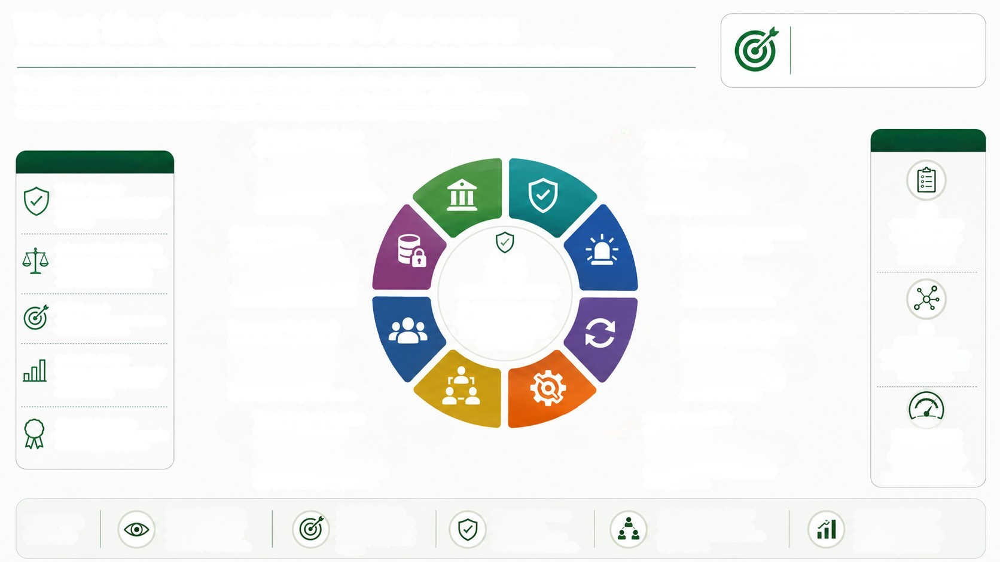
What the Questionnaire Assesses
Enterprise-wide coverage across 8 interconnected cyber, operational and resilience risk domains
PURPOSE
To assess the effectiveness and maturity of
key cyber security and operational risk
controls across the organisation.
The questionnaire is designed to provide a comprehensive and balanced view of cyber resilience.
It covers 36 core questions across 8 risk domains-spanning governance, prevention, detection, response,
recovery, third parties, people and data-aligned to leading standards and regulatory expectations.
Information & Cyber
Security Governance
4 QUESTIONS
02
Cyber Security
Defences & Testing
4 QUESTIONS
AT A GLANCE
WHY THIS MATTERS
Holistic Coverage
Spans the full spectrum of cyber and
operational risk domains, not just
technology.
Strategy, governance framework,
policies, accountability, assurance
and asset visibility.
Vulnerability management, penetration
testing, endpoint & network defence,
and cryptographic controls.
36
Data Protection,
Privacy, CSR & Fraud
10 QUESTIONS
03
Incident Management &
Breach Response
CORE QUESTIONS
Designed for clarity,
consistency and
proportionality.
Balance of Depth & Breadth
Focused set of core questions with
the option to go deeper using
child questions and evidence.
36
3 QUESTIONS
Incident response capability,
communication, monitoring
and post-incident review.
Privacy governance, data inventory
& rights, breach notification, ethics,
whistleblowing and fraud controls.
980
CORE QUESTIONS
8 RISK DOMAINS
One integrated assessment.
covering the full cycle of
cyber resilience
Risk-Focused
Criticality weighting ensures focus
Personnel, Training &
Access Management
5 QUESTIONS
Access control, MFA, privileged
access, security awareness,
screening and background checks.
Business Continuity &
Disaster Recovery
3 QUESTIONS
Business continuity planning,
disaster recovery, backups
and recovery testing.
8
on what matters most.
04
RISK DOMAINS
Covering the full spectrum
of cyber, operational and
resilience risks.
Actionable Insights
Produces a risk-weighted maturity
view to drive informed decisions
and prioritisation.
Aligned & Defensible
Built using recognised frameworks
and industry good practices.
Third-Party & Vendor
Risk Management
4 QUESTIONS
05
Operational Risk
Management
3 QUESTIONS
RISK-WEIGHTED
MATURITY VIEW
Enables prioritisation,
benchmarking and
continuous improvement.
Third-party due diligence, ongoing
monitoring, supply-chain exposure
and exit contingency planning.
Operational risk governance,
incident remediation and secure
change / SDLC.
WHAT THIS
DELIVERS
Enterprise Visibility
One view of cyber and
operational resilience
across the organisation.
Better Decisions
Risk-based insights to
focus resources where
they have the greatest
impact.
Stronger Resilience
Identifies gaps,
strengthens controls
and improves readiness.
Stakeholder Confidence
Demonstrates governance,
accountability and continuous
Aligned to Standards
Built on NIST CSF 2.0,
ISO 27001:2022, DORA
and industry practices.
improvement.

